Slide 1
Software Testing and Quality Assurance
Haiming Liu
liuhaiming@bjtu.edu.cn
School of Software Engineering
Beijing Jiaotong University

Slide 2
16 Weeks Plan
Week 1: The basic concepts and theories of testing
Week 2-3: Principles of Testing
Week 4: Test Cases
Week 5-8: Black Box Testing
Week 9-11: White Box Testing
Week 12: Integration Testing and System Testing
Week 13: Usability Testing and Accessibility Testing
Week 14: Security Testing
Week 14: Mutation Testing
Week 15: Software Quality
Week 16: Review I

Slide 3
TESTING FUNDAMENTALS
TESTING THE SOFTWARE
WITH X-RAY GLASSES
Notes:
由于是动态的就一定要测试运行中的程序，由于是白盒就一定要检查盒子里面，检查代码并观察运行状态。
这就好像带上X光眼镜测试软件
这就要求测试人员，完全知道程序的结构和处理方法，这种方法按照程序的内部结构的逻辑运行，检测程序中的主要执行通路和是否都能按预定要求正确执行。

Slide 4
Basis path test example 1
scanf(“%d %d”,&x, &y)
if (y < 0)
pow = -y;
else
pow = y;
z = 1.0;
while (pow != 0) {
z = z * x;
pow = pow - 1;
}
if (y < 0)
z = 1.0 / z;
printf (“%f”,z);
Please draw the control flow graph of the following code and provide the cyclomatic complexity V(G) of the control flow graph;
Please provide the Basis Path set of the control flow graph;
Notes:
【腾讯文档】Basis path test example 1
https://docs.qq.com/form/page/DSFdHVllleEZnQnVa

Slide 5
Basis path test example 1
scanf(“%d %d”,&x, &y)
if (y < 0)
pow = -y;
else
pow = y;
z = 1.0;
while (pow != 0) {
z = z * x;
pow = pow - 1;
}
if (y < 0)
z = 1.0 / z;
printf (“%f”,z);
scanf(“%d %d”,&x, &y)
if (y < 0)
pow = -y;
else
pow = y;
z = 1.0;
while (pow != 0) {
z = z * x;
pow = pow - 1;
}
if (y < 0)
z = 1.0 / z;
printf (“%f”,z);

Slide 6
Basis path test example 1
1
1 scanf(“%d %d”,&x, &y)
2 if (y < 0)
3 pow = -y;
4 else
5 pow = y;
6 z = 1.0;
7 while (pow != 0) {
8 z = z * x;
9 pow = pow - 1;
10 }
11 if (y < 0)
12 z = 1.0 / z;
13 printf (“%f”,z);
2
4
3
5
6
7
11
8
12
9
13
10

Slide 7
Basis path test example 1
1
1 scanf(“%d %d”,&x, &y)
2 if (y < 0)
3 pow = -y;
4 else
5 pow = y;
6 z = 1.0;
7 while (pow != 0) {
8 z = z * x;
9 pow = pow - 1;
10 }
11 if (y < 0)
12 z = 1.0 / z;
13 printf (“%f”,z);
2
Region 1
3
4，5
Region 4
6
7
11
Region 2
Region 3
12
8，9，10
13

Slide 8
Basis path test example 1
1
Path1: 1-2-3-6-7-11-13
2
Path2: 1-2-3-6-7-8-9-10-7-11-13
3
4，5
Path3: 1-2-4-5-6-7-11-13
6
Path4: 1-2-4-5-6-7-11-12-13
7
11
12
8，9，10
13

Slide 9

Determine a basis set of linearly independent paths
Independent path any path that introduces at least one new set of processing statements or a new condition
Basis set set of independent paths through the code
Test cases derived from a basis set are guaranteed to execute every statement at least one time during testing
Basis set is not unique
Notes:
确定线性独立路径的基本集合
独立路径 引入至少一组新的处理语句或新条件的任何路径
Basis set®通过代码的独立路径集从基集派生的
测试用例保证在测试期间至少执行每条语句一次
基本集合不唯一

Slide 10
Test cases to execute each path in the basis set
you do not need an activity diagram, but the picture will help when you trace component paths
count each logical test—compound tests count as the number of Boolean operators + 1 (i.e., count each simple predicate)
basis path testing should be applied to all components, if possible, and to critical components always
Basis path testing does not test all possible combinations of all paths through the code; it just tests every path at least once.

Slide 11
Basis path test example 2
for (j=1; j<N; j++)
{
3 last = N - j + 1;
4 for (k=1; k<last; k++)
5 {
6 if (list[k] > list[k+1])
7 {
8 temp = list[k];
9 list[k] = list[k+1];
10 list[k+1] = temp;
11 }
12 }
13 }
14 print(“Done\n”);
Please draw the control flow graph of the following code and provide the cyclomatic complexity V(G) of the control flow graph;
Please provide the Basis Path set of the control flow graph;

Slide 12
Basis path test example 3
/* COUNT
This program counts the number of characters and lines in a text file.
INPUT: Text File
OUTPUT: Number of characters and number of lines.
*/
1 main(int argc, char *argv[])
2 {
3 int numChars = 0;
4 int numLines = 0;
5 char chr;
6 FILE *fp = NULL;
7
8 if (argc < 2)
9 {
10 printf(“\nUsage: %s <filename>”, argv[0]);
11 return (-1);
12 }
13 fp = fopen(argv[1], “r”);
14 if (fp == NULL)
15 {
16 perror(argv[1]); /* display error message */
17 return (-2);
18 }
19 while (!feof(fp))
20 {
21 chr = getc(fp); /* read character */
22 if (chr == ‘\n’) /* if carriage return */
23 ++numLines;
24 else
25 ++numChars;
26 }
27 printf(“\nNumber of characters = %d”, numChars);
28 printf(“\nNumber of lines = %d”, numLines);
29 }
Notes:
转向并不存在的标号
没有用的语句标号
从程序入口进入后无法到达的语句
不能到达退出程序的语句

Slide 13
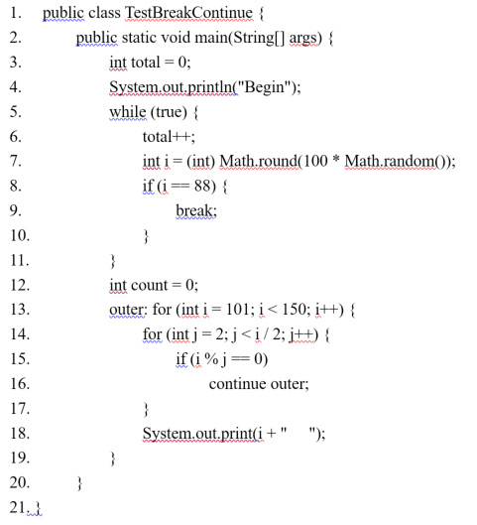
Basis path test example 4
Notes:
转向并不存在的标号
没有用的语句标号
从程序入口进入后无法到达的语句
不能到达退出程序的语句

Slide 14
To be continued… See you next week

